Slide 1
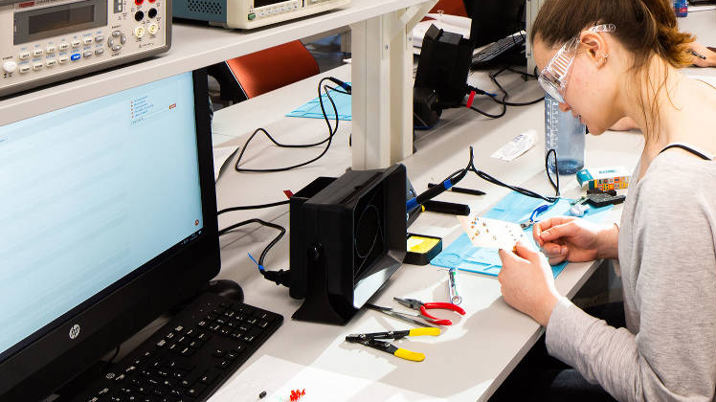
Remote Electronics Laboratories
Jack Renshaw (z5114675) UG Thesis 2021/22

Slide 2
Context
Move towards remote education
Institutional Incentives
Student-Driven
HD Video Streaming, Conference Calls, Lecture Recordings
COVID-19 Accelerated the trend

Slide 3

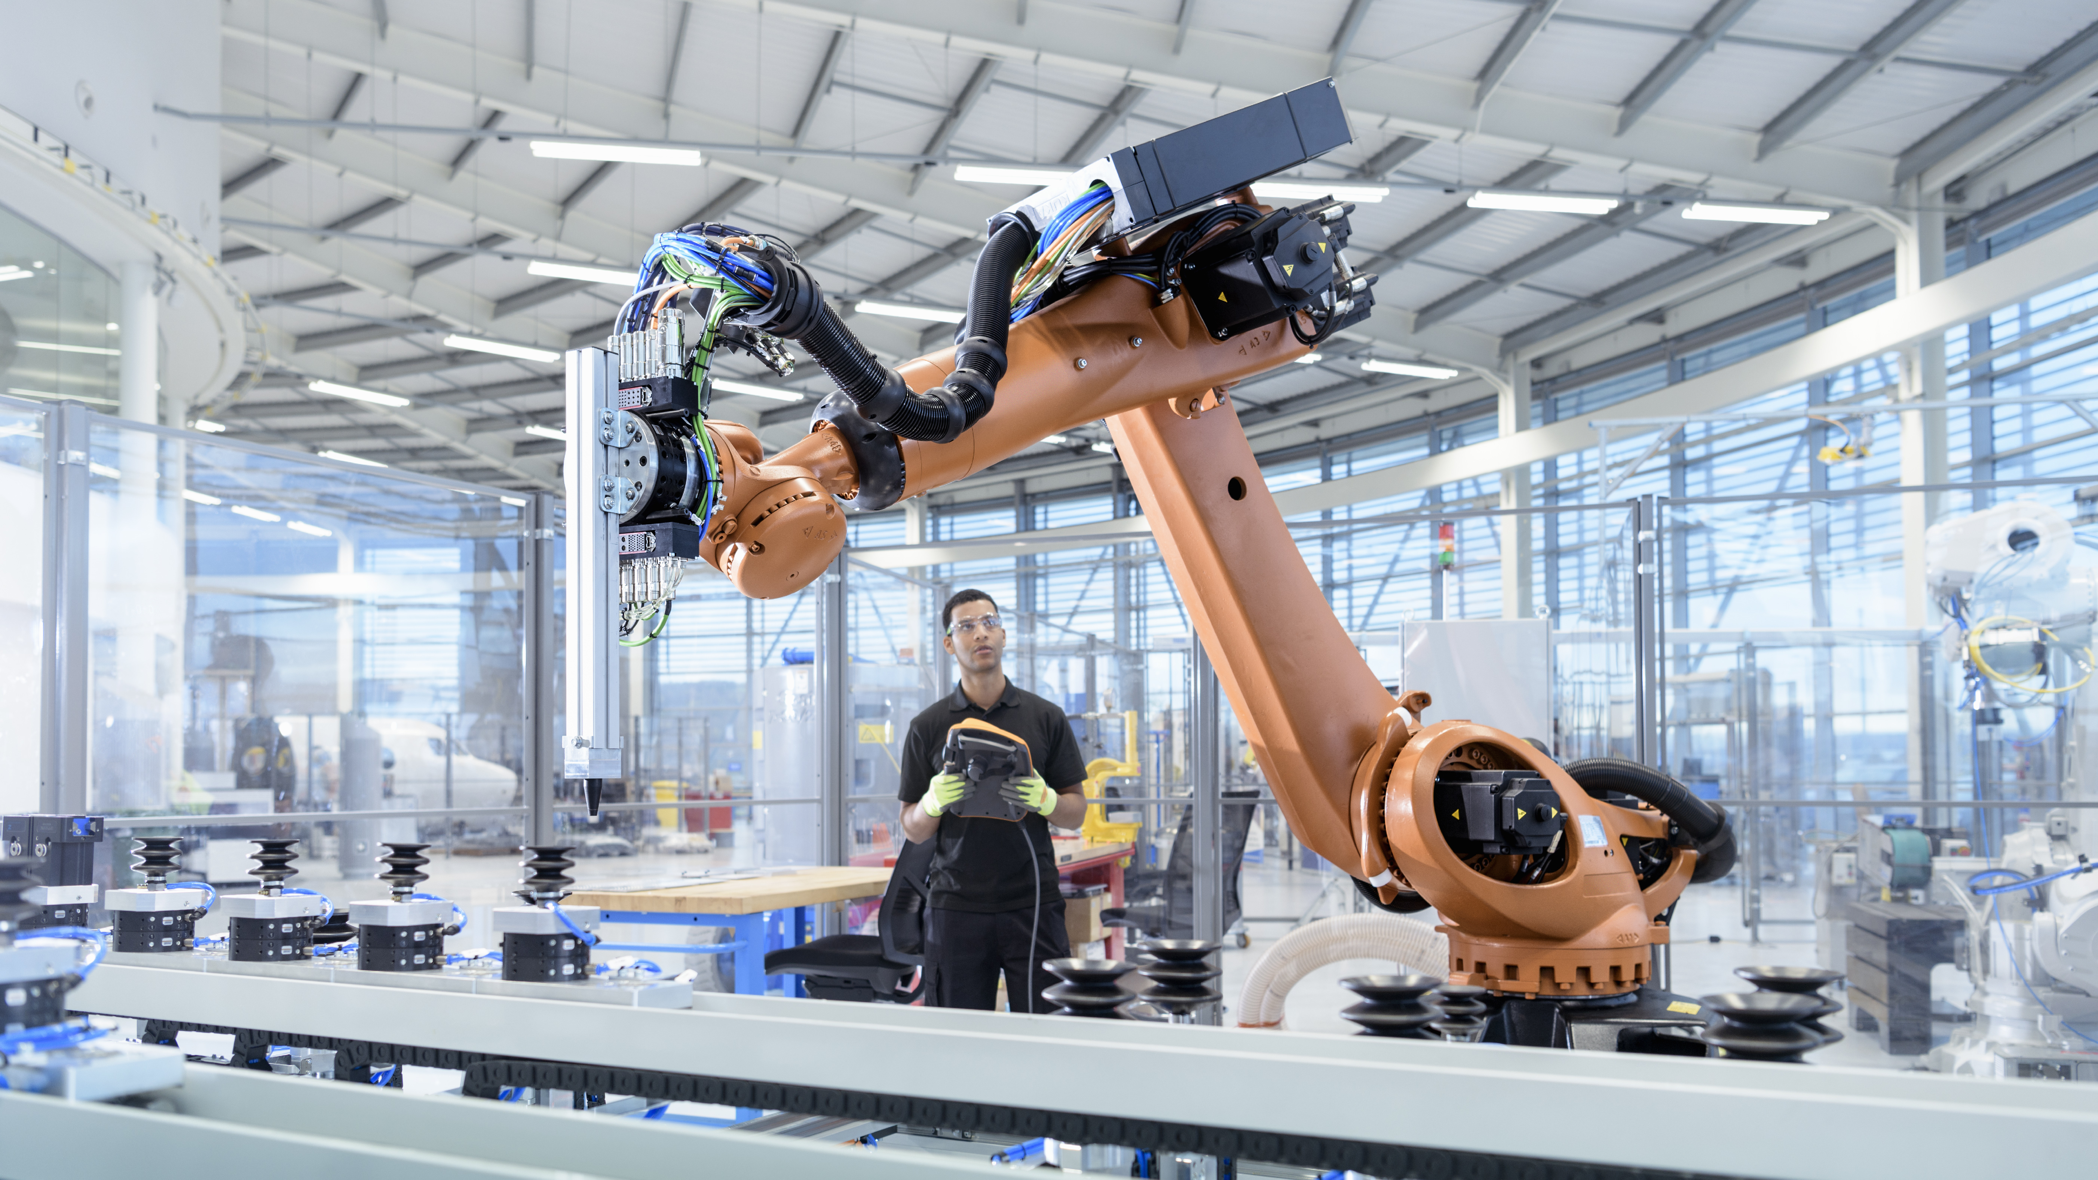



Purpose of Laboratories

Slide 4
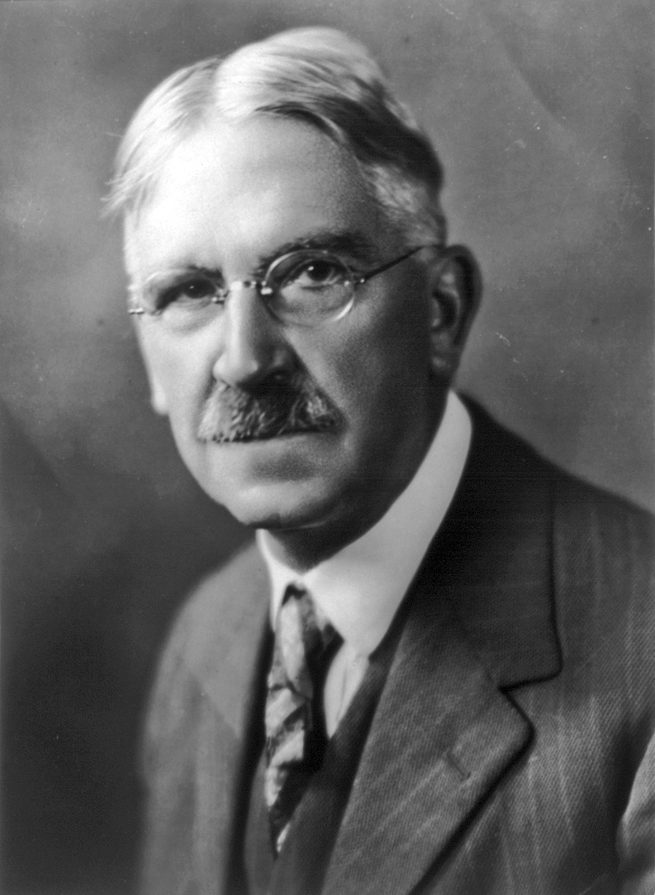
The Pedagogy of Laboratories
1.

Slide 5
Laboratories within Electronics Engineering
1.

Slide 6
A Concrete Example – Lab 1 ELEC2133
1. Lab investigates non-idealities of OPAMPs (LM301A)
A. Measuring propagation delay, slew rate, bandwidth
B. Investigating the effects of compensation capacitors on the above
The lab problematizes the ‘ideal’ OPAMP by introducing real world effects Teaches students a theoretical framework for understanding the non-ideal aspects of OPAMPs (in terms of parameters) Introduces a practical method for overcoming limitations (cap compensation)

Slide 7

Current Solutions in Academic Literature
Jack Renshaw (z5114675) UG Thesis 2021/22

